Slide 1

Review 2.3
B. Tech. Project (19ECE495)
Batch ID: 070
Mutual coupling reduction in MIMO Patch Antenna Array for Wi-Fi and Bluetooth applications
MENTOR: Ms. V. MEKALADEVI
Dept. of Elec. and Commn. Engg.
Amrita School of Engineering, Coimbatore
CB.EN.U4ECE22225 | - | J Rohith
CB.EN.U4ECE22262 | - | Peddakudala Yashwanth
CB.EN.U4ECE22213 | - | Chundupalle Tej Siddanth

Slide 2
Motivation:
MIMO antennas are widely used in smartphones, routers, Bluetooth, and IoT devices to improve data rate and communication reliability.
In compact devices, closely spaced antenna elements cause mutual coupling, which reduces isolation and overall antenna performance.
Increasing antenna spacing is often not possible due to limited device size.
Effective decoupling techniques are required to minimize mutual coupling while maintaining a compact design.
This project aims to design a compact 2.4 GHz MIMO antenna with improved isolation, stable radiation characteristics, and better signal quality.

Slide 3
Challenges:
Achieving good isolation between antenna elements while keeping the antenna array compact for practical wireless devices.
Identifying and optimizing a suitable decoupling technique that improves isolation without negatively affecting gain, bandwidth, or operating frequency.
Accurately setting up and analyzing simulations in HFSS, including meshing, boundary conditions, and S-parameter evaluation.
Ensuring that simulated results closely match real-world measurements despite fabrication tolerances and component losses.
Maintaining precision during fabrication and testing, including antenna dimensions, SMA connector integration.

Slide 4
Literature Survey
S.No | Title of the Paper | Source | Inference (Decoupling Method & Limitations) | Year
1 | Decoupling Between Extremely Closely Spaced Patch Antennas by Mode Cancellation Method | IEEE Transactions on Antennas and Propagation | • Two probe-fed microstrip patches at 2.45 GHz with 0.016λ₀ (2 mm) edge-to-edge spacing. • Mode Cancellation Method (MCM): a lumped inductance or small inductive strip inserted between patches creates a current with 180° opposite phase to cancel unwanted coupled current. • Isolation improved from ~5 dB to >15 dB. Gain ~8.9 dBi; symmetric broadside beam maintained. • Limitation: Narrow-band improvement; lumped component adds fabrication complexity; performance sensitive to inductance tolerances; not extended to >2 elements; no ECC reported. | 2020
2 | Mutual Coupling Reduction of a Dual-Band Four-Port Patch Antenna With Co-Polarised Radiation Pattern by Controlling Electric Fields | IEEE Transactions on Antennas and Propagation | • Single-layer dual-band 4-port rectangular patch at 2.35 GHz and 3.59 GHz; co-polarised probe-feed configuration. • Characteristic Mode Analysis (CMA) used to guide placement of shorting pins and ring slots; alters modal field distribution to push E-field nulls toward unexcited ports. • Mutual coupling reduced to below −15 dB across both bands; stable broadside beam; low-profile single-layer design; no external decoupling network. • Limitation: CMA expertise required; sensitive to pin and slot placement tolerances; single radiator limits spatial diversity; no gain or efficiency data reported. | 2023
3 | A Compact Multifrequency Broadband Dual-Antenna System With Mutual Coupling Reduction for Wi-Fi 6E Application | IEEE Antennas and Wireless Propagation Letters | • Dual Inverted-F Antenna (IFA) on FR4 (εr=4.4, h=1 mm); size 6.5×41 mm²; covers 2.4–2.484 GHz, 5.15–5.825 GHz, 5.925–7.125 GHz. • Three-stage decoupling: Inductor L1 (3.6 nH) for 2.4 GHz; modified branch L2 (22 nH) for 5–6 GHz; modified neutralisation line L3 (28 nH) for higher frequencies. Phase cancellation of mutual currents. • Isolation >22 dB across Wi-Fi 6E bands. Gain: 4.27 dBi @ 2.4 GHz and 4.43 dBi @ 5–7 GHz. ECC <0.3; efficiency >40%; omnidirectional pattern. • Limitation: Low radiation efficiency (>40%); three separate inductors increase cost and assembly complexity; ECC near 0.3 limit; not suitable for very compact IoT devices. | 2024

Slide 5
S.No | Title of the Paper | Source | Inference (Decoupling Method & Limitations) | Year
4 | Mutual Coupling Reduction in Dual-Band MIMO Antenna Using Parasitic Dollar-Shaped Structure for Modern Wireless Communication | IEEE Access | • Dual-band monopole MIMO on FR4 (εr=4.4, 0.8 mm); size 45×30 mm²; CPW feed; bands: 2.39–2.57 GHz and 3.82–6.95 GHz. • Parasitic Dollar-Shaped Structure (PDSS): two interlocking C-shaped loops + vertical rectangular strip acting as stop-band filter; suppresses surface waves between monopoles. • Isolation −15 dB across both bands; gain ~2.6 dBi; efficiency 70–75%; ECC <0.02. • Limitation: Isolation of −15 dB is below typical 20 dB target; low gain (2.6 dBi); complex PDSS geometry harder to fabricate precisely; large antenna footprint. | 2023
5 | Electric-Field Null Bending of a Single Dual-Port Patch Antenna for Colinear Polarisation Decoupling Using Characteristic Modes Analysis | IEEE Transactions on Antennas and Propagation | • Single-layer dual-port MPA at 5.30–5.54 GHz; probe-fed (two symmetrical feed points); for IBFD and MIMO systems. • CMA used to combine TM01 and TM20 resonant modes to bend E-field nulls toward unexcited ports. Six shorting pins + circular slots for impedance matching. No external decoupling structure needed. • Isolation −17 dB (improved from −3.5 dB baseline); gain ~5.0 dBi; same-polarisation transmission; good simulation-measurement agreement. • Limitation: Operates only at 5 GHz; shorting pins complicate fabrication; isolation of −17 dB may be insufficient for strict IBFD; no ECC or MIMO capacity analysis. | 2022
6 | Wideband Self-Decoupled Closely Placed Dielectric Patch Antenna Array Without Additional Structures | IEEE / Chinese Journal | • Dielectric Patch Antenna (DPA) array at 4.7–5.3 GHz; microstrip-coupled slot feed on Rogers substrate; 2-element extended to 4-element. • Self-decoupling by simultaneous excitation of two dielectric modes via appropriate dielectric constant selection. No additional decoupling structures required. • Isolation >21 dB; 10.5% bandwidth; beam scanning up to ±46° in E-plane. • Limitation: Limited to dielectric patch antennas; dielectric resonators are bulkier and costlier than patches; design sensitive to dielectric constant selection; not validated for 2.4 GHz band. | 2022

Slide 7
S.No | Title of the Paper | Source | Inference (Decoupling Method & Limitations) | Year
7 | Self-Decoupled 8-Element Dual Polarised MIMO Antenna for B5G Handsets With Sub-6 GHz and mmWave Integration | IEEE Access | • 8-element dual-polarised MIMO (slot-based) on RO4003C (0.8 mm); sub-6 GHz (4.7–4.9 GHz, n79) and mmWave (28–29 GHz, n257). • Orthogonal placement of elements for polarisation diversity. F-shaped slots with slotted ground plane for dual resonance. High isolation achieved by element arrangement alone — no external decoupling structures. • Isolation >14.4 dB @ sub-6 GHz; >25 dB @ mmWave. Gain: 4.9 dBi (n79), 7.2 dBi (n257). Efficiency ~90%. • Limitation: Isolation at sub-6 GHz (14.4 dB) below 20 dB target; slotted ground may affect ground-plane-dependent circuitry; large board required; limited to specific 5G bands. | 2024
8 | Mode-Counteraction Based Self-Decoupling in Circularly Polarised MIMO Microstrip Patch Array | IEEE Transactions on Antennas and Propagation | • CP Microstrip Patch Array (MIMO) at ~5.45–5.63 GHz; coaxial probe (diagonal-fed to excite TM10 and TM01 modes); 1×2 extended to 1×4. • Mode counteraction effect: two orthogonal modes (TM10 and TM01) excited to generate CP and create null-field in adjacent patch. Second patch feed placed in null-field for natural isolation. • Isolation ~−59.4 dB (extremely low coupling); gain ~4.8 dBi; 3 dB AR bandwidth ~2.15% (5.52–5.64 GHz); no external decoupling needed. • Limitation: Narrow 3 dB axial ratio bandwidth (~2.15%); works only for CP antennas; diagonal probe feed sensitive to fabrication tolerances; slight frequency shift due to PCB tolerance reported. | 2022
9 | A Self-Decoupling Method for MIMO Antenna Array Using Characteristic Mode of Ground Plane | IEEE Transactions on Antennas and Propagation, vol. 71, no. 3 | • Various antenna types on common ground plane at ~3.9–4.0 GHz; versatile — applicable to different array configurations. • Characteristic Mode 2 of the ground plane creates two null-field regions. First antenna excites Mode 2; second antenna's feed placed in null-field. No additional decoupling structures. Analysed using Altair Feko. • Isolation up to 57 dB; method versatile across different antenna types. • Limitation: Requires accurate characterisation of ground plane modes (Feko expertise); antenna placement constrained by null-field location; ground plane size affects modal behaviour; difficult in irregular ground configurations. | 2023

Slide 8
S.No | Title of the Paper | Source | Inference (Decoupling Method & Limitations) | Year
10 | Compact Self-Isolated Four-Element MIMO Antenna for WLAN and ISM Bands | IEEE Access | • 4-element printed dipole MIMO at 2.25–2.87 GHz (WLAN/ISM 2.4 GHz); integrated λ/4 balun feeding. • Self-isolation through orthogonal dipole arrangement (smart element placement) in compact square layout + printed decoupling element to suppress residual coupling. No external decoupling networks. • High isolation achieved by structural arrangement; simple and manufacturable design; demonstrates that thoughtful arrangement can achieve isolation without adding complexity. • Limitation: Isolation level not precisely quantified; only validated for WLAN/ISM bands; no ECC or radiation efficiency data reported; limited scalability beyond 4 elements. | 2022
11 | A Low-Profile Decoupling Structure for Mutual Coupling Suppression in MIMO Patch Antenna | IEEE Transactions on Antennas and Propagation | • MIMO microstrip patch antenna (sub-6 GHz range); low-profile, same-layer structure. • Phase cancellation principle: additional coupling path with 270° phase shift introduced to cancel original 90° coupled signal. Entire structure on same layer as patches — no extra layers. Scalable to 3-element array. • Significant coupling suppression demonstrated; compact and low-profile; easy to implement; compared favourably to metasurfaces and EBG structures in terms of size and complexity. • Limitation: Isolation value not precisely quantified; narrowband cancellation — sensitive to frequency; phase balance critical for fabrication tolerances; no ECC or efficiency data; gain impact not clearly quantified. | 2021
12 | A Parasitic Decoupling Structure for Dual-Polarised Patch Antenna Arrays | IEEE Antennas and Wireless Propagation Letters | • 1×2 dual-polarised patch antenna array at 4.3 GHz; probe feed; for STAR (simultaneous transmit and receive) systems. • Parasitic L-section array suppresses co-vertical polarisation (CVP) coupling; parasitic U-section array targets co-horizontal polarisation (CHP) coupling. Additional coupling path with ~180° opposite phase for vector superposition cancellation. Same-layer placement. • Isolation: 37.5 dB (CHP) and 33.6 dB (CVP) — 17–18 dB improvement over reference. Efficiency improved from 84% to 91%; ECC <0.004. • Limitation: Effective only at 4.3 GHz (narrow band); two separate parasitic structures increase design complexity; optimisation is iterative; not validated for 2.4 GHz or sub-6 GHz bands. | 2022

Slide 9
S.No | Title of the Paper | Source | Inference (Decoupling Method & Limitations) | Year
13 | Performance Enhancement of MIMO Patch Antenna Using Parasitic Elements | IEEE Access | • MIMO microstrip patch array (E-plane and H-plane configurations); standard microstrip feed. • Multiple square parasitic patches placed near main radiating elements. Part of the energy that would normally couple is attracted to passive patches instead, reducing direct mutual coupling. Creates additional resonances, improving impedance bandwidth. No ground plane modification. • Isolation >40 dB in narrow frequency range; improved realised gain (increased radiating aperture); low ECC; scalable to multi-element E-plane arrays. • Limitation: Very high isolation (>40 dB) only in narrow frequency range; bandwidth enhancement may shift resonant frequency; multiple parasitic patches increase footprint; no specific frequency or substrate data provided. | 2021
14 | Sub-6 GHz Highly Isolated Wideband MIMO Antenna Arrays | IEEE Access | • 2-element wideband MIMO patch array; sub-6 GHz for LTE and 5G applications; compact with closely spaced elements (much less than λ/2). • Thin parasitic strip between facing radiating edges, positioned at the region of strongest EM interaction. Modifies surface current distribution to reduce energy transfer between elements. • Isolation >−20 dB over most of operating band; ECC <0.05; diversity gain near theoretical maximum; stable broadside radiation; nearly omnidirectional azimuth pattern. • Limitation: Isolation drops at band edges; thin parasitic strip sensitive to dimensional tolerances; no specific gain value provided; radiation pattern distortion analysis limited. | 2022
15 | Mutual Coupling Reduction of a Circularly Polarized MIMO Antenna Using Parasitic Elements and DGS for V2X Communications | IEEE Access | • 4-element CP MIMO patch array at 5.850–5.925 GHz (V2X/vehicular); square patches with truncated corners for RHCP; minimum spacing 8.65 mm. • Two combined techniques: (1) Truncated-corner patches for CP + orthogonal placement for polarisation diversity; (2) Circular ring parasitic structures between perpendicularly placed elements + DGS to suppress coupling surface currents. • Isolation >34 dB (up to 65 dB for adjacent elements), improved from 21–28 dB baseline; ECC <0.001; diversity gain ~10 dB; channel capacity loss <0.15 bits/Hz; supports V2X up to 1.5 km at 21 dBm TX power. • Limitation: Operates only in vehicular band (5.85–5.925 GHz); DGS complicates ground plane integration; circular ring parasitic structures add design complexity; fabrication of truncated-corner patches requires precision. | 2023

Slide 10
S.No | Title of the Paper | Source | Inference (Decoupling Method & Limitations) | Year
16 | Mutual Coupling Reduction in an Antenna Array by Using Two Parasitic Microstrips | Int. J. Electron. Commun. (AEÜ) | • 2-element rectangular microstrip patch array at 2.4 GHz; substrate εr=2.2, h=3.2 mm + upper dielectric layer; 50-Ω coaxial probe feed. • Two parasitic microstrips etched on an additional thin dielectric layer above the radiating patches. Not directly connected — function through electromagnetic coupling. Parametric optimisation of strip length, patch spacing, and upper layer thickness (h2). • Measured mutual coupling <−32 dB; S11 <−30 dB; gain 6.2–6.4 dB; minimal radiation pattern impact; good simulation-measurement agreement. • Limitation: Requires additional dielectric layer — increases antenna profile and cost; upper layer thickness is a sensitive parameter; more complex two-layer fabrication; narrow-band improvement; not evaluated for MIMO metrics (ECC, diversity gain). | 2021
17 | A Two-Port Microstrip Antenna with High Isolation for Wi-Fi 6 and Wi-Fi 6E Applications | IEEE Transactions on Antennas and Propagation | • Dual-port microstrip patch antenna; Port 1: 5.41–6.07 GHz; Port 2: 5.58–7.49 GHz; for Wi-Fi 6 and Wi-Fi 6E. • Decoupling probe along symmetry plane modifies common-mode (CM) impedance while leaving differential-mode (DM) unchanged. CM and DM reflection responses matched at centre frequency for cancellation. Independent matching networks with lumped inductors (~1.5 nH, 0.7 nH) + bandpass filters for full-band isolation. • Peak isolation ~42 dB at 6.03 GHz; maintained across band with filters; supports multi-band operation. • Limitation: Bandpass filters introduce insertion losses (1.7–2.3 dB); lumped inductors add cost and assembly complexity; isolation is frequency-sensitive (peak only at 6.03 GHz); not applicable to 2.4 GHz band; complex feeding network increases antenna size. | 2022
18 | A Dual-Port MIMO Antenna Decoupling by Common and Differential Mode Cancellation with High Isolation | IEEE Antennas and Wireless Propagation Letters | • Dual-port MIMO antenna for sub-6 GHz wireless systems; compact structure with shorting pins and metallic strips. • Common-mode and Differential-mode (CM/DM) cancellation using shorting pins and metallic strips placed on same layer. Suppresses coupling currents without ground plane modifications. Symmetrical configuration provides pattern diversity between ports. • Isolation >25 dB; measured gain 2–3.14 dBi; stable radiation characteristics across operating band; compact geometry. • Limitation: Low gain (2–3.14 dBi) limits range performance; shorting pins complicate PCB fabrication; CM/DM balance sensitive to symmetry tolerances; not validated specifically for 2.4 GHz/Bluetooth band; ECC data not reported. | 2025

Slide 11
Methodology :
Design a 2.4 GHz rectangular microstrip patch antenna using Rogers RT/Duroid 5880 substrate.
Develop a 1×2 MIMO antenna array and analyze mutual coupling effects.
Implement neutralization line and parasitic element techniques for coupling reduction.
Optimize the proposed parasitic element with anti-parallel antenna configuration.
Simulate the antenna in ANSYS HFSS and evaluate S₁₁, S₂₁, gain, and radiation characteristics.
Compare the performance of different decoupling techniques and identify the most effective solution for isolation improvement.

Slide 12
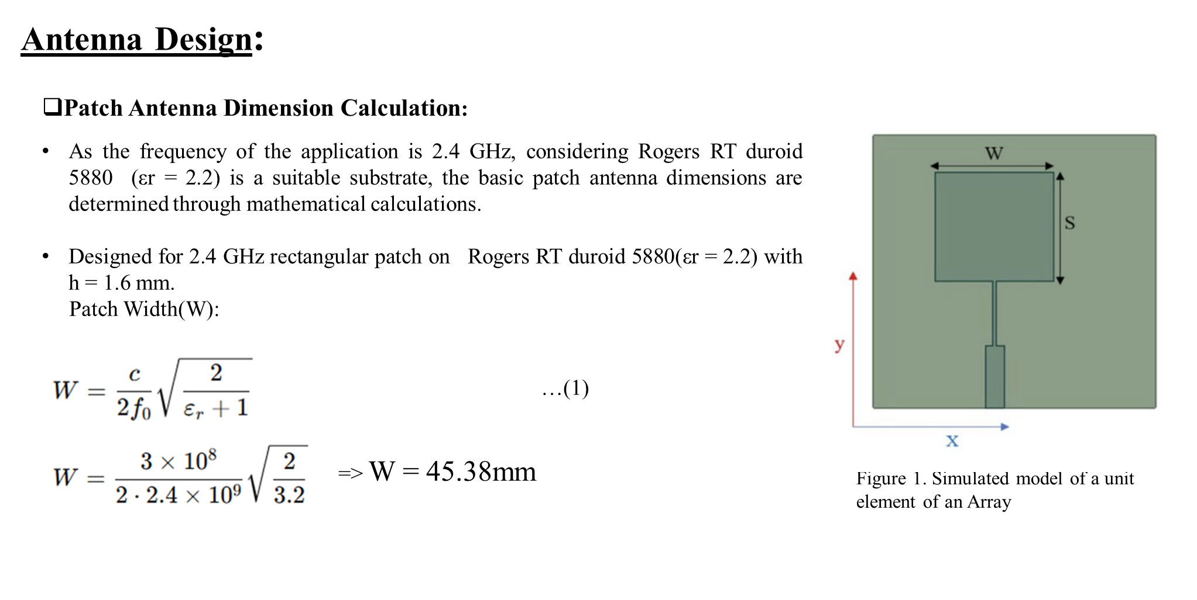

Slide 13
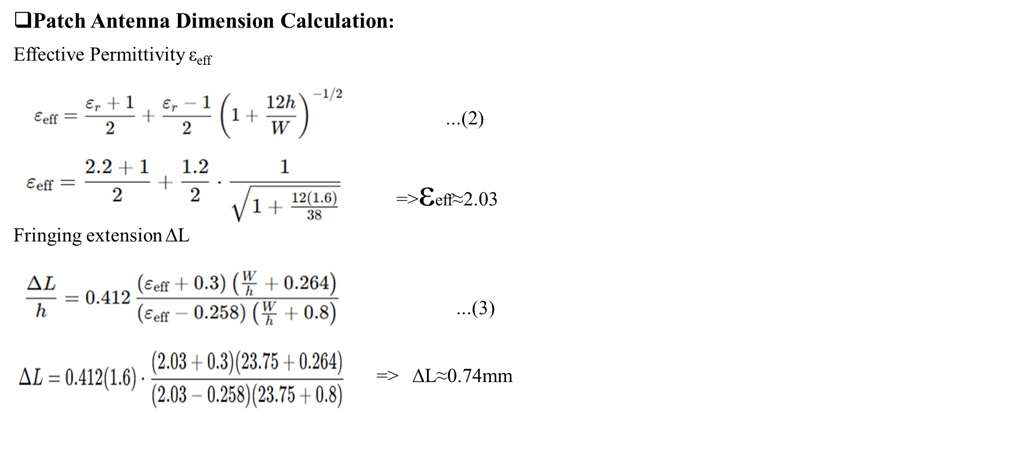

Slide 14
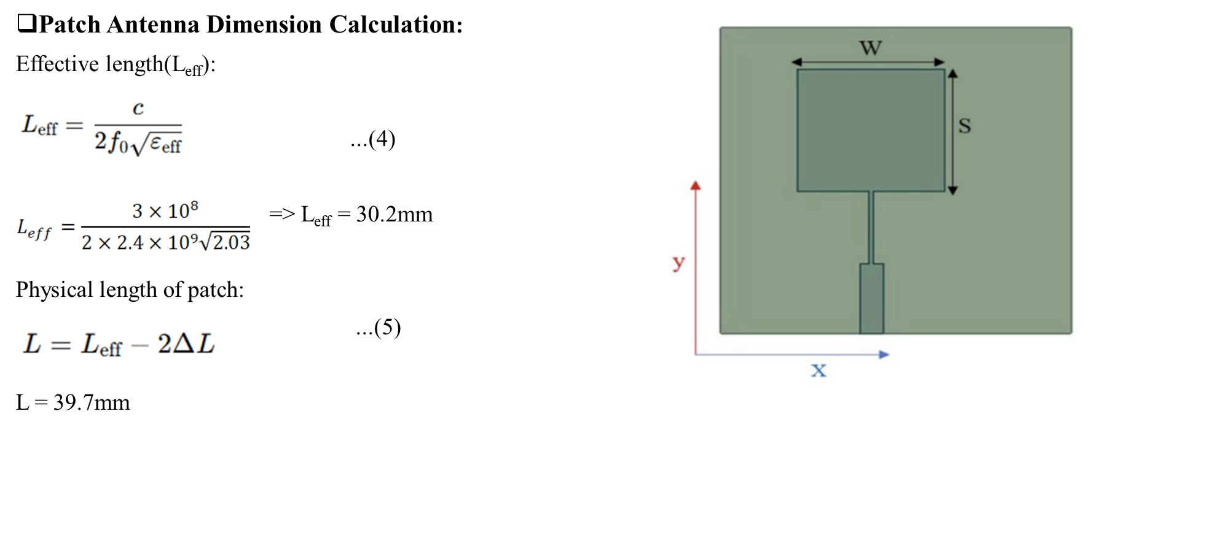

Slide 15
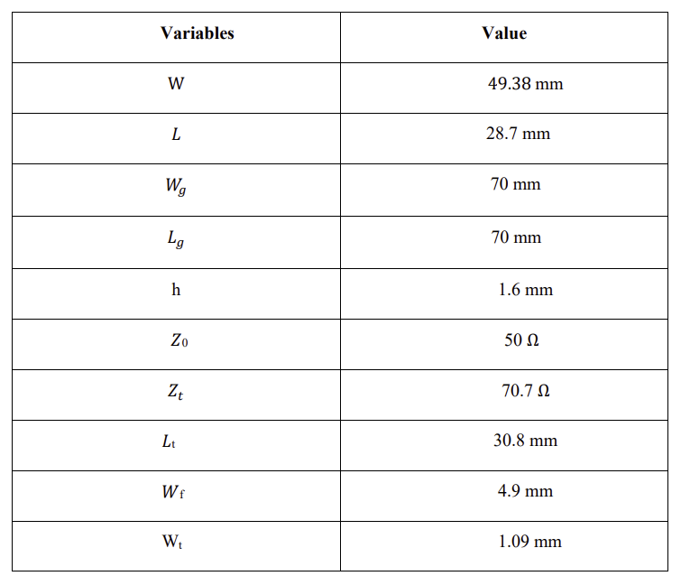
Calculated Dimensions for Single Element

Slide 16
Two-element MIMO array:
A 1×2 linear microstrip patch antenna array was designed using two identical 2.4 GHz rectangular patches on Rogers RT/Duroid 5880 substrate.
The objective was to improve gain and directivity while maintaining proper impedance matching.
Each patch was fed through a quarter-wave transformer connected to a 50 Ω feedline.
The antenna elements were spaced approximately 0.5λ₀ apart, enabling constructive radiation in the broadside direction and reducing unwanted grating lobes.
The array retained the same patch dimensions and substrate properties as the single-element design, ensuring consistent performance and efficient power distribution.

Slide 17
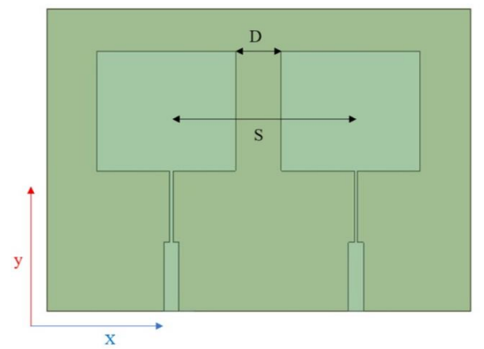
Two-element MIMO array:
Variable | Value | Value in terms of λ₀
D(edge to edge) | 24.6 mm | 0.2 λ₀
S(centre to centre) | 71.4mm | 0.56 λ₀
Table 2 – Spacing between the antennas
Fig 2 Two-element MIMO array

Slide 18
Design of a two-element patch antenna array incorporating a neutralisation line:
Neutralisation Line (NL) :
A neutralization line (NL) is a thin metallic strip placed between two antenna elements to create an additional coupling path.
It carries a current that is equal in magnitude but 180° out of phase with the unwanted coupling current.
Through destructive interference, the NL cancels the induced coupling current between the antennas.
This reduces the amount of energy transferred to the adjacent antenna element, thereby improving isolation (lower S₂₁).
The effectiveness of the NL depends on its electrical length and placement, which are optimized to achieve maximum coupling suppression.

Slide 19


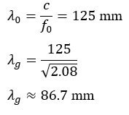
Design of a two-element patch antenna array incorporating a neutralisation line:
Neutralisation Line Length Calculation
For 180° phase shift:
Where guided wavelength:
Free-space wavelength:

Slide 20
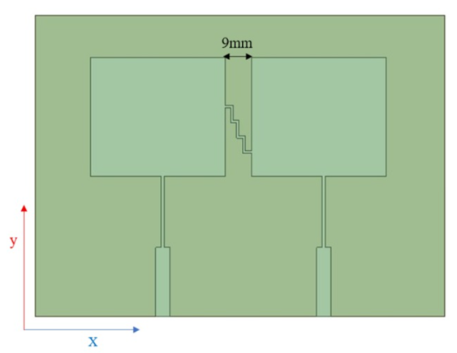

Design of a two-element patch antenna array incorporating a neutralisation line:
Neutralisation Line Length:
Neutralisation Line Width:
The width controls coupling strength.
Start with:W_{NL} = 0.5 mm – 1 mm
Placement Guidelines:
Connect between the two feed lines (near the inset feed region)
Or connect between patch edges where the surface current is maximum
Maintain symmetry
Figure 3-Two-element array with neutralisation line

Slide 21
Design of a two-element patch antenna array incorporating a parasitic element:
Parasitic Elements :
A parasitic element is placed between the antenna elements to create a controlled coupling path.
When one antenna is excited, the parasitic element intercepts the electromagnetic energy that would otherwise couple to the adjacent antenna.
Due to its carefully optimized length, the induced current on the parasitic element is opposite in phase to the unwanted coupling current.
The two currents undergo destructive interference, reducing the energy transferred between the antennas.
This results in improved isolation (lower S₂₁) and better overall MIMO antenna performance.

Slide 22
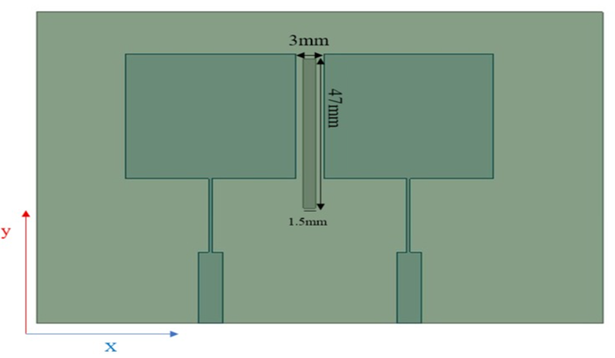
Design of a two-element patch antenna array incorporating a parasitic element:
Parameters:
Free space wavelength: λ₀ =125mm
Length of the parasitic element = 47.5 mm = 0.38λ₀
Width = 1.5mm
Figure.4-Two-element array with parasitic element

Slide 23
Final proposed structure- Parasitic element with anti-parallel antenna configuration
Two rectangular patch antennas are arranged face-to-face, creating strong electromagnetic interaction due to their close spacing.
A vertical parasitic strip is placed between the patches in the region of highest electric field intensity.
The parasitic strip acts as a passive tuning element, supporting induced currents that modify the surface current distribution.
By controlling the strip dimensions and spacing, the coupling between antenna elements can be reduced while maintaining a compact structure.
This controlled interaction improves isolation, impedance matching, and overall antenna performance without increasing antenna size.

Slide 24
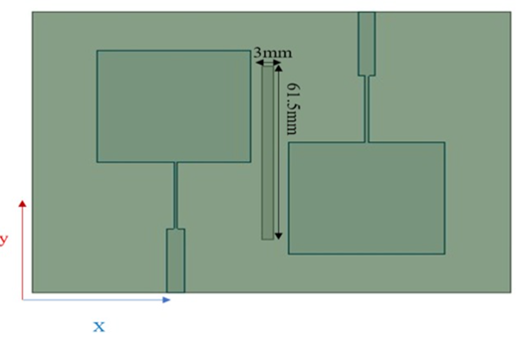
Final proposed structure- Parasitic element with anti-parallel antenna configuration
Figure.5 Final proposed structure-Parasitic element withh anti-parallel antenna configuration

Slide 25
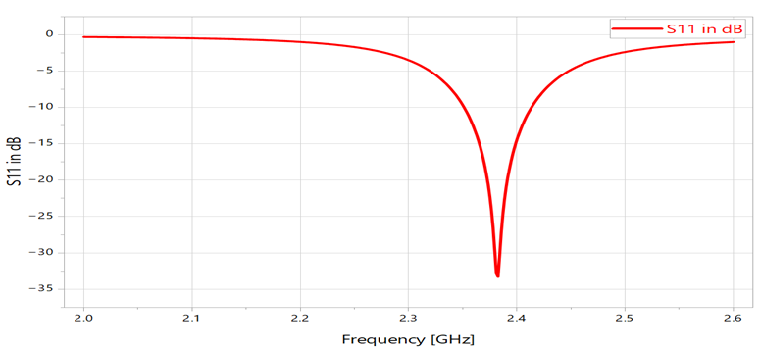
Results and Discussion :
Performance analysis of a single-element antenna:
Figure 6-Simulated S-parameter of a single element
As shown in Figure 6, antenna design has sufficiently good input matching (where ∣S11|= -10 dB) at 2.4 GHz (-27.33 dB).

Slide 26
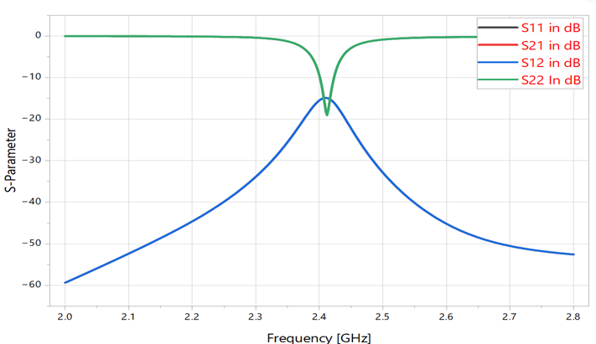
Results and Discussion :
Performance analysis of Two-element array:
Figure 7-Simulated S-parameter plot of a two-element array

Slide 27
Results and Discussion :
Performance analysis of Two-element array with a parasitic element:
In the basic two-element array, the antennas were separated by 7 mm (0.056λ₀), resulting in high mutual coupling (S₂₁ ≈ −7.5 dB) and a return loss of −16 dB at 2.389 GHz.
A parasitic strip was introduced between the antenna elements to reduce unwanted electromagnetic interaction.
The resonant frequency shifted closer to the target frequency, reaching 2.404 GHz, with improved impedance matching (S₁₁ ≈ −24.6 dB).
Mutual coupling was significantly reduced to approximately −13.2 dB, indicating improved isolation.
The parasitic element modifies the surface current distribution, weakening the coupling path while maintaining a compact antenna structure.

Slide 28
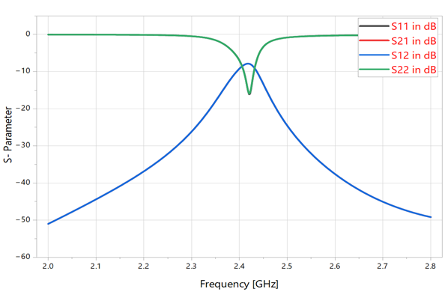
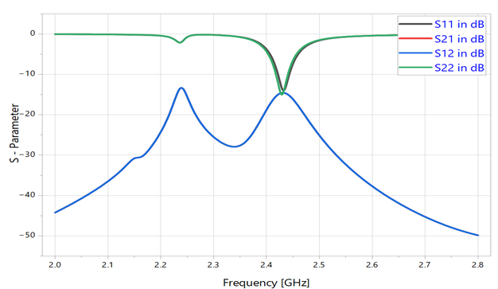
Results and Discussion :
Performance analysis of Two-element array with a parasitic element:
Figure 8- Simulated S parameter of a 1×2 Patch antenna Array without a parasitic element
Figure 9- Simulated S parameter of a 1×2 Patch antenna Array with a parasitic element

Slide 29
Results and Discussion :
Performance analysis of the final proposed structure-parasitic element with anti-parallel antenna configuration:
After optimizing the parasitic strip with anti-parallel antenna configuration, the antenna achieved improved overall performance.
The antenna resonates at 2.428 GHz, close to the target 2.4 GHz ISM band, with excellent impedance matching (S₁₁ ≈ −22.7 dB).
Mutual coupling was significantly reduced to S₂₁ ≈ −17.4 dB, indicating strong isolation between the antenna elements.
Isolation improvement compared to previous stages:
Basic Array: −7.5 dB
Parasitic Element: −13.2 dB
Final Proposed Structure: −17.4 dB
The proposed design achieved an isolation improvement of nearly 10 dB, confirming the effectiveness of the parasitic strip in suppressing unwanted coupling while maintaining a compact antenna structure.

Slide 30
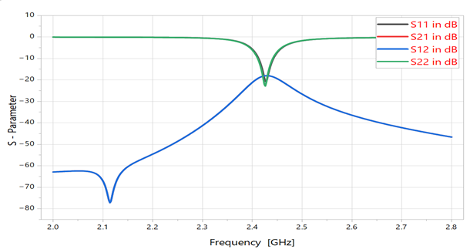
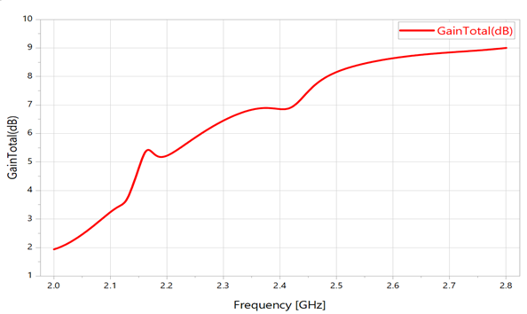
Results and Discussion :
Performance analysis of the final proposed structure-parasitic element with anti-parallel antenna configuration:
Figure 10- Simulated S parameter of a 1×2 Patch antenna Array without a parasitic element with anti-parallel antenna configuration
Figure 11- Simulated Gain plot of a 1×2 Patch antenna Array with a parasitic element with anti-parallel antenna configuration

Slide 31
Comparison of results:
In the basic two-element array, the antenna elements were closely spaced (7 mm), resulting in high mutual coupling of −7.5 dB.
Introducing a neutralization line improved isolation, reducing mutual coupling to approximately −11.7 dB.
Replacing the neutralization line with a parasitic element further improved isolation to about −13.2 dB by modifying the surface current distribution.
The optimized parasitic element with anti-parallel configuration provided the best performance, achieving −17.4 dB isolation at 2.428 GHz.
Overall, the proposed structure delivered nearly 10 dB improvement in isolation while maintaining a compact antenna design.

Slide 32
Comparison of results:
Table 3 Comparison of results
Method of mutual coupling reduction | S21 without modifying the two-element array structure(in dB) | S21 after modifying the two-element array structure (in dB)
Neutralisation line | 7.5 | 11.7
Parasitic element | 7.5 | 13.2
Final proposed structure: Parasitic element with anti-parallel antenna configuration | 7.5 | 17.4

Slide 33
Conclusion:
A compact 1×2 microstrip patch antenna array operating at 2.4 GHz was designed for Wi-Fi and Bluetooth applications.
The project focused on reducing mutual coupling between closely spaced antenna elements using a parasitic decoupling structure.
The antenna was designed and optimized in ANSYS HFSS by tuning the parasitic element geometry and antenna spacing.
The final design achieved good impedance matching, stable radiation characteristics, and an isolation of approximately 17.4 dB.
A gain of around 7 dBi was obtained, demonstrating the effectiveness of the proposed structure for compact wireless communication systems.

